Slide 1
AUTOMATED API DISCOVERY AND FINGERPRINTING.

Slide 2
INTRODUCTION
Automated API discovery and fingerprinting is like having a smart helper for computer programs. It's a tool that finds and understands the secret ways (called APIs) that let different computer programs talk to each other. Just like finding hidden paths, it discovers these ways so that all kinds of programs can work together smoothly. This is really important because it helps computers and apps share information easily, making everything we do online or on our devices work better and faster.
The fingerprinting part of this tool is also cool because it looks at each API very closely, just like noticing all the unique details of a person's fingerprint. This means it can tell exactly how each API works, what it's good at, and what problems it might have. Knowing all these details helps keep our digital world organized and safe. It's like making sure everyone playing a game knows the rules and plays by them, which makes the game more fun and fair for everyone.

Slide 3
RESEARCH OBJECTIVE
The objective of this research was to develop an automated, efficient methodology for the discovery, classification, and documentation of APIs across multiple platforms, including SwaggerHub, Postman, and GitHub. By overcoming the challenges of varied documentation standards, unstructured data, dynamic content, and the need for automated classification and integration, the project aimed to enhance the accessibility, integration, and management of APIs. This would facilitate a deeper understanding of the API ecosystem, improve interoperability among software applications, and contribute valuable insights to the broader field of API management and cybersecurity.

Slide 4
RESEARCH CHALLENGES
Adapting to Varied Documentation Standards: Each tool or platform may use different standards for API documentation, requiring adaptability.
Navigating Unstructured Data: GitHub, in particular, can have very unstructured data, making it challenging to systematically classify and analyze APIs.
Dealing with Dynamic Content: Tools like Postman might struggle with dynamic content when automating API discovery, requiring more sophisticated solutions.
Automating Classification Processes: Automatically categorizing APIs based on their functionality or industry can be complex due to the nuances in API documentation.
Integrating Across Diverse Platforms: Creating a workflow that integrates findings from SwaggerHub, Postman, and GitHub into a cohesive research or project outcome requires careful planning and execution.

Slide 5
SOLUTIONS FOR RESEARCH CHALLENGES
Addressing the challenges encountered during the research project involved a series of strategic approaches and solutions:
Utilized Python scripts for dynamic adaptation to various JSON and XML structures encountered across SwaggerHub, Postman, and GitHub.
Implemented advanced data mining techniques and regular expressions to identify and extract relevant API information from GitHub's unstructured repositories. This approach facilitated the systematic classification and analysis of APIs.
Leveraged browser automation tools like Selenium to interact with and extract data from dynamically loaded content in Postman. This allowed for the successful automation of API discovery processes despite the challenges of dynamic web pages.

Slide 6
Research Works :
Postman: Successfully extracted nearly 535,000 pieces of data into a CSV file, showcasing the tool's robust capability in API testing and documentation extraction. This vast amount of data highlights the potential for comprehensive API analysis and management.
SwaggerHub: Managed to classify and pull about 300,000 data points, demonstrating SwaggerHub's effectiveness in organizing and managing API documentation in a structured environment.
GitHub and Other Open Sources: GitHub and other open-source platforms were integral to discovering a vast array of APIs, contributing to the rich dataset used in the project. These platforms, known for their unstructured data, posed unique challenges that were addressed through innovative data extraction and classification techniques. The project's engagement with GitHub and open-source resources significantly broadened the scope of API discovery, highlighting the diversity and potential of publicly available API documentation.
Throughout this research, practical knowledge was gained in utilizing tools like Porch Pirate and its SwaggerHub counterpart, enhancing the project's efficiency in data extraction and management. This comprehensive approach to API documentation discovery across multiple platforms and tools has laid a robust foundation for future endeavors in API management and cybersecurity.

Slide 7
STATISTICS
Source | Key Statistics
Postman | Api Data Extracted: Approximately 535,000
SwaggerHub | APIs Data: ~300,000
GitHub | Covered Categories: Animals, Anime, Art & Design, Books, Business, etc.

Slide 8
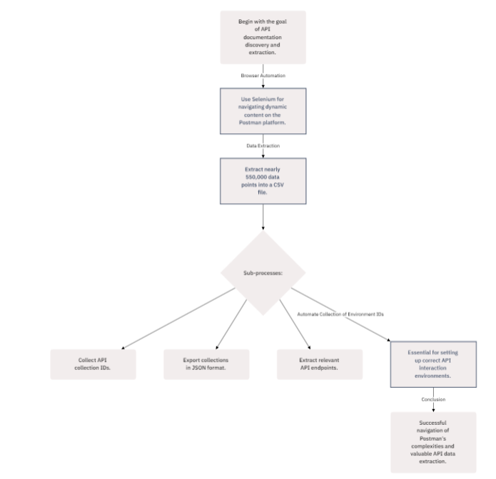
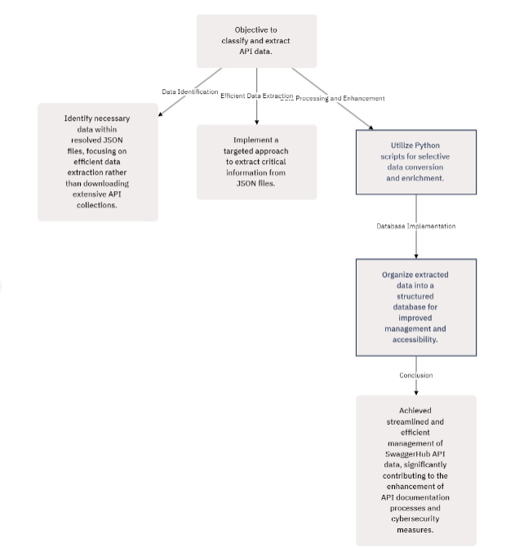
WORK FLOW DIAGRAMS FOR POSTMAN AND SWAGGERHUB

Slide 9
POSTMAN ANALYSIS
In the Postman segment of the research project, a comprehensive strategy was implemented for the discovery, extraction, and organization of API documentation. The endeavor leveraged Selenium for browser automation to navigate Postman's dynamic content challenges, successfully extracting nearly 5,50,000 data points into a CSV file. This extraction highlighted the platform's vast API documentation, with specific processes developed for collecting API collection IDs, exporting these collections in JSON format, and extracting relevant API endpoints from this data. Despite encountering challenges like the extensive processing time due to Postman's vast content pages and occasional omissions of APIs with detailed documentation, the project innovated by proposing a relational database for efficient data management. This database streamlined the organization of extracted data, addressing issues of redundancy and incomplete entries. The project concluded by automating the collection of environment IDs from Postman workspaces, a crucial step for setting up correct API interaction environments. This comprehensive approach to managing Postman's API documentation underscored the project's success in navigating the complexities of dynamic web content and extracting valuable API data, contributing significantly to the fields of API management and cybersecurity.

Slide 10
SWAGGERHUB ANALYSIS
The SwaggerHub segment of the project involved a detailed process to extract and process data from over 300,000 APIs into a structured CSV database. This included downloading JSON files, identifying base URLs, and making API requests for comprehensive data retrieval.
A specialized API request was crafted to paginate through the vast repository of SwaggerHub's APIs, meticulously designed to handle the substantial volume of data. This approach facilitated the retrieval of a rich dataset, including API names, descriptions, version information, and details on server and contact points, ensuring a holistic view of the API landscape.
The initially retrieved data was stored in a text file, serving as a manageable format for the subsequent transformation into CSV. A dedicated Python script was then used to convert this JSON data into a structured CSV format, significantly enhancing the dataset with additional server and contact information for each API. This documentation, supplemented with Python scripts for data retrieval, JSON to CSV conversion, and dataset enhancement, offers a comprehensive guide to the methodology employed in managing and analyzing the extensive data from SwaggerHub's API repository.

Slide 11
Learnings :
Experience with tools like SwaggerHub and Postman was enhanced, leading to a better grasp of API discovery and documentation management.
Insights into the critical role of structured classification for improving API integration and management were gained.
The exploration of automation revealed its importance in navigating the challenges of dynamic web content and unstructured data, contributing to more efficient API documentation processes.
Familiarity with new tools, including Burp Suite and Porch Pirate, was developed, expanding capabilities in security testing and API exploration.
Through engaging with a plethora of software tools and resources on open sources and GitHub, navigation and utilization skills for research and development were improved.
Skills in documentation and reporting were sharpened, aiding in the effective communication of findings and progress.

Slide 12
Time management abilities were refined, learning to juggle multiple tasks and deadlines with increased efficiency.
Participation in networking and interaction activities helped in forging valuable connections within the tech community.
The value of teamwork was deeply appreciated, highlighted by collaborative project efforts and participation in extracurricular activities, leading to winning MVP in a football tournament and a team victory in a cricket tournament organized by Securin.
This comprehensive experience not only expanded technical knowledge but also enriched interpersonal skills, setting a solid foundation for future endeavors in the tech industry.

Slide 13
THANK YOU

